Slide 1
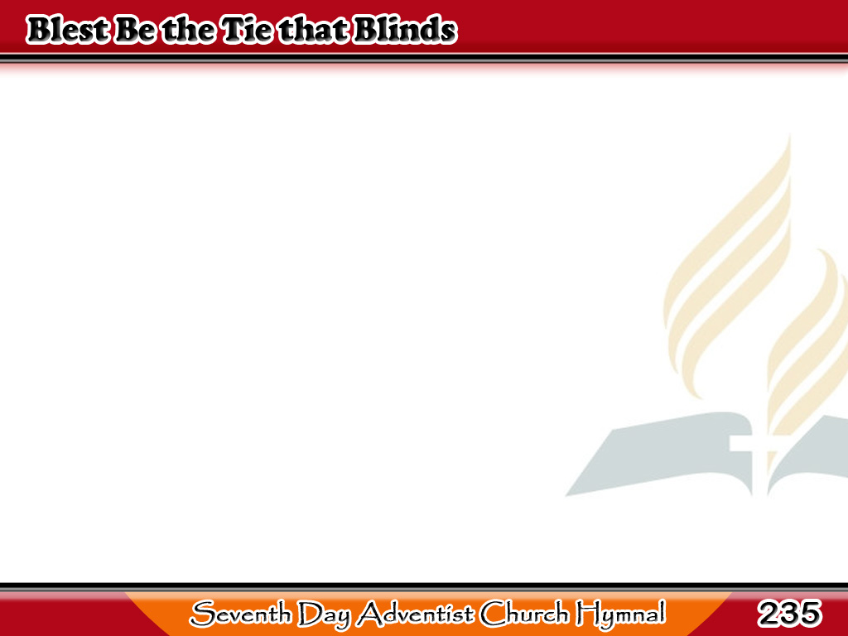
Pagpalain Nawa
Blest be the tie that binds
Our hearts in Christian love!
The fellowship of kindred minds
Is like to that above.
1/4

Slide 2
Pagpalain Nawa
Before our Father’s throne
We pour our ardent prayers;
Our fears, our hopes,
our aims are one,
Our comforts, and our cares.
2/4

Slide 3
Pagpalain Nawa
We share our mutual woes,
Our mutual burdens bear,
And often for each other flows
The sympathizing tear.
3/4

Slide 4
Pagpalain Nawa
When we asunder part,
It gives us inward pain;
But we shall still
be joined in heart,
And hope to meet again.
4/4

